Slide 1
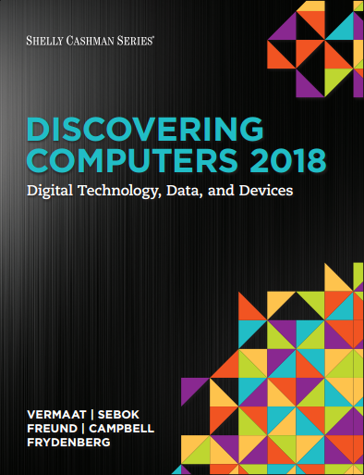

DISCOVERING COMPUTERS 2018 Digital Technology, Data, and Devices
Module 2
Connecting and Communicating Online:
The Internet, Website, and Media
Copyright © 2018 Cengage Learning®. May not be scanned, copied or duplicated, or posted to a publicly accessible website, in whole or in part.

Slide 2
Objectives Overview (1 of 2)
Discuss the evolution of the Internet
Briefly describe various broadband Internet connections
Describe the purpose of an IP address and its relationship to a domain name
Describe features of browsers and identify the components of a web address
Describe ways to compose effective search text

Slide 3
Objectives Overview (2 of 2)
Explain benefits and risks of using online social networks
Describe uses of various types of websites
Explain how the web uses graphics, animation, audio, video, and virtual reality
Explain how email, email lists, Internet messaging, chat rooms, online discussions, VoIP, and FTP work
Identify the rules of netiquette
Notes:
Figure 2.1 Exercise/exercise dropout cycle

Slide 4
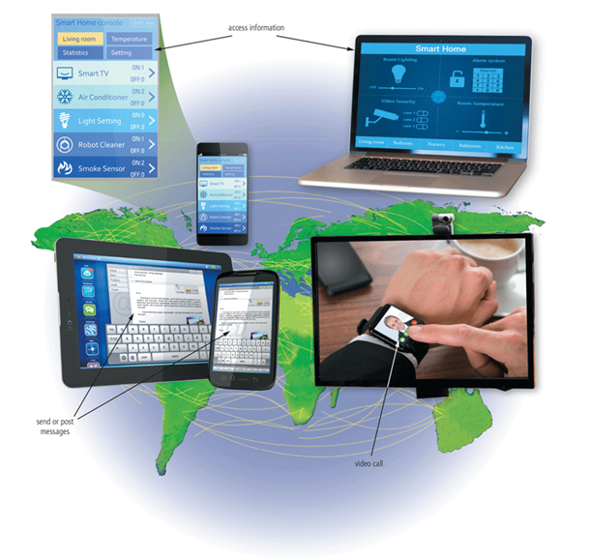
The Internet (1 of 3)
The Internet is a worldwide collection of networks that connects millions of businesses, government agencies, educational institutions, and individuals
Figure 2-1 People around the world use the internet in daily activities, such as accessing information, exchanging messages, and conversing with others from their computers and mobile devices.

Slide 5
The Internet (2 of 3)
The Internet originated as ARPANET in September 1969 and had two main goals:
Allow scientists at different physical locations to share information and work together
Function even if part of the network were disabled or destroyed by a disaster

Slide 6
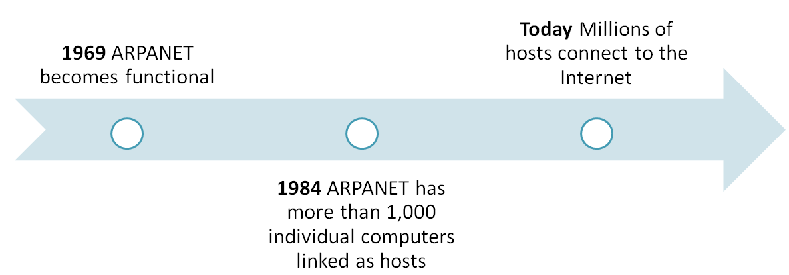
The Internet (3 of 3)
Notes:
Our environment is not conducive to a healthy, physically active lifestyle.

Slide 7
Birthday of the Internet?

Slide 8
Connecting to the Internet (1 of 10)
With wired connections, a computer or device physically attaches via a cable or wire to a communications device
Computers without a communications device can use a wireless modem or other communications device that enables wireless connectivity

Slide 9
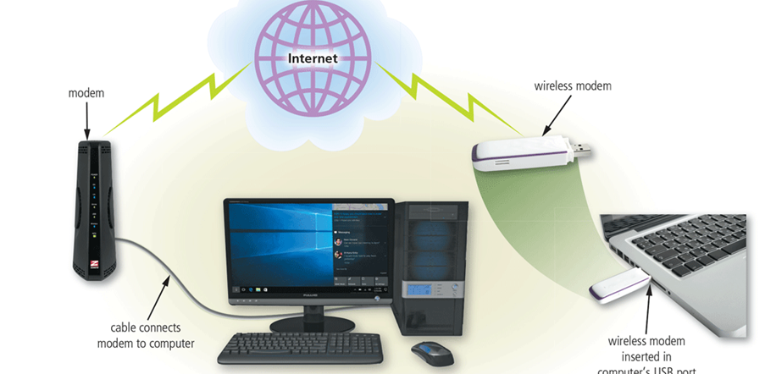
Connecting to the Internet (2 of 10)
Figure 2-2 Using a modem is one way to connect computers and mobile devices to the Internet.

Slide 10
Connecting to the Internet (3 of 10)
Wired
Cable Internet service
DSL (digital subscriber line)
Fiber to the Premises (FTTP)
Wireless
Wi-Fi (wireless fidelity)
Mobile broadband
Fixed wireless
Satellite Internet Service

Slide 11
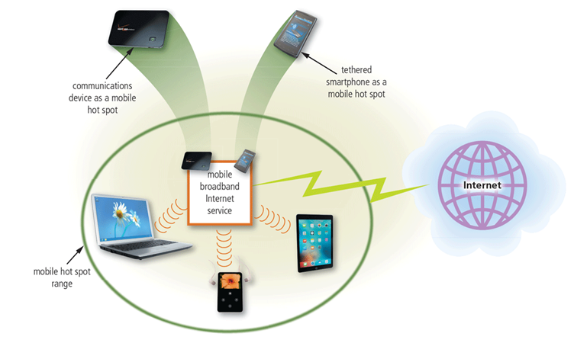
Connecting to the Internet (4 of 10)
A hot spot is a wireless network that provides Internet connections to mobile computers and devices
Figure 2-3 You can create a mobile hot spot using a communications device or by tethering a smartphone.

Slide 12
Connecting to the Internet (5 of 10)
An Internet service provider (ISP) is a business that provides individuals and organizations access to the Internet free or for a fee
Bandwidth is a measure of the capability of a network to send and receive data
Megabyte (MB)
Gigabyte (GB)

Slide 13
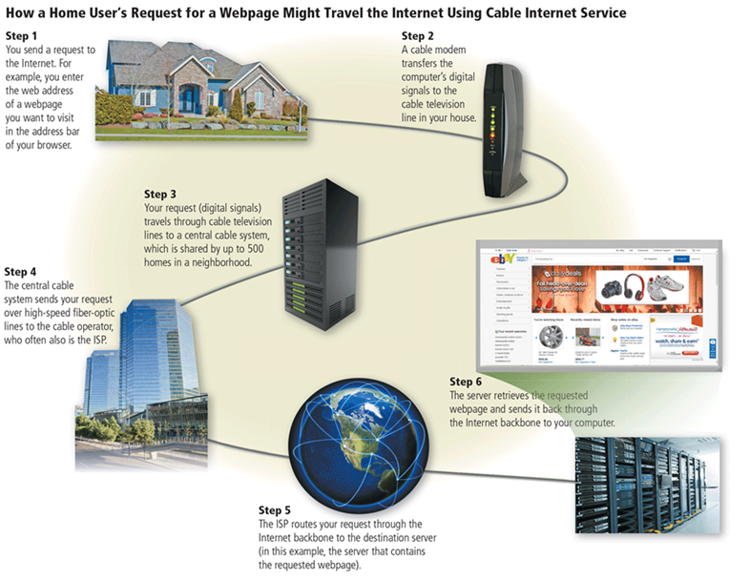
Connecting to the Internet (6 of 10)
Figure 2-4 This figure shows how a home user’s request for eBay’s webpage might travel the internet using cable Internet service.

Slide 14
Connecting to the Internet (7 of 10)
An IP address is a sequence of numbers that uniquely identifies the location of each computer or device connected to the Internet or any other network
A domain name is a text-based name that corresponds to the IP address of a server
A DNS server translates the domain name into its associated IP address

Slide 15
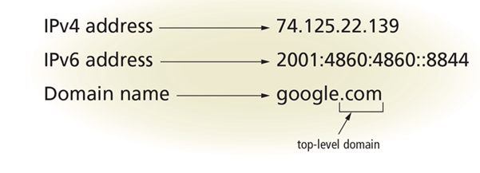
Connecting to the Internet (8 of 10)
Figure 2-5 The IPv4 and IPv6 addresses, along with the domain name for Google's website.

Slide 16
Connecting to the Internet (9 of 10)
Table 2-3 Popular Generic TLDs
TLD | Intended Purpose
.biz | Businesses
.com | Commercial organizations, businesses, and companies
.edu | Educational institutions
.gov | Government agencies
.mil | Military organizations
.museum | Museums and individual museum professionals
.name | Individuals
.net | Network providers or commercial companies
.org | Nonprofit organizations
.technology | Technology information
Remark: .mo is not a generic TLD, it is called a country code TLD.

Slide 17
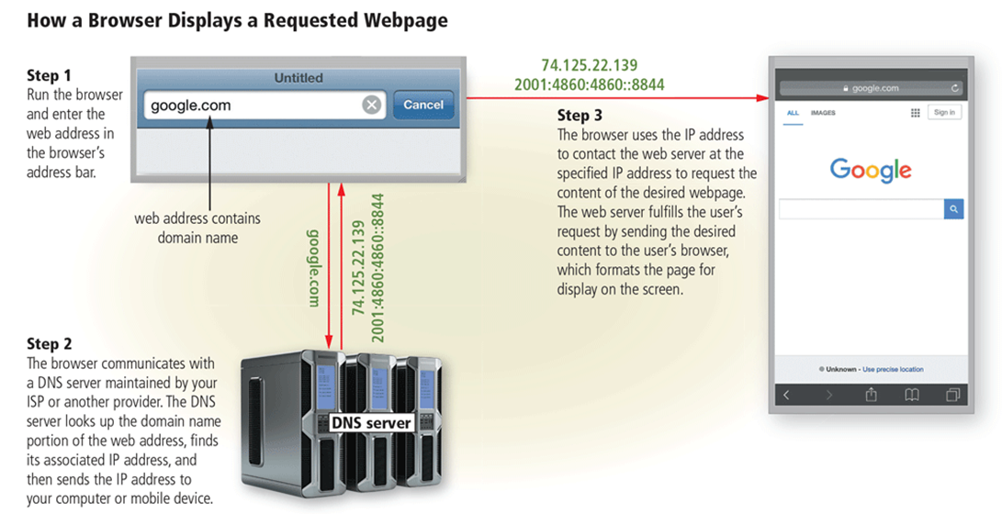
Connecting to the Internet (10 of 10)
Figure 2-6 This figure show how a user’s entered domain name (google.com) uses a DNS server to display a webpage (Google, in this case).

Slide 18
The World Wide Web (1 of 5)
The World Wide Web (WWW), or web, consists of a worldwide collection of electronic documents (webpages)
A website is a collection of related webpages and associated items
A web server is a computer that delivers requested webpages to your computer or mobile device
HTML (Hypertext Markup Language) is a set of symbols that developers use to specify the headings, paragraphs, images, links, and other content elements that a webpage contains

Slide 19
The World Wide Web (2 of 5)
A browser is an application that enables users with an Internet connection to access and view webpages on a computer or mobile device
Internet-capable mobile devices such as smartphones use a special type of browser, called a mobile browser
A home page is the first page that a website displays
Current browsers typically support tabbed browsing

Slide 20
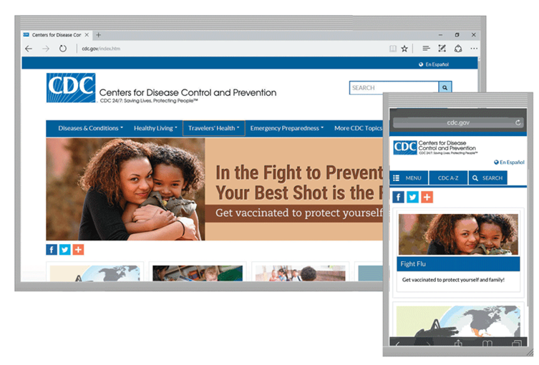
The World Wide Web (3 of 5)
Figure 2-7 Many websites, such as the Centers for Disease Control and Prevention shown here, provide a mobile version that is designed specifically for display on a mobile browser.

Slide 21
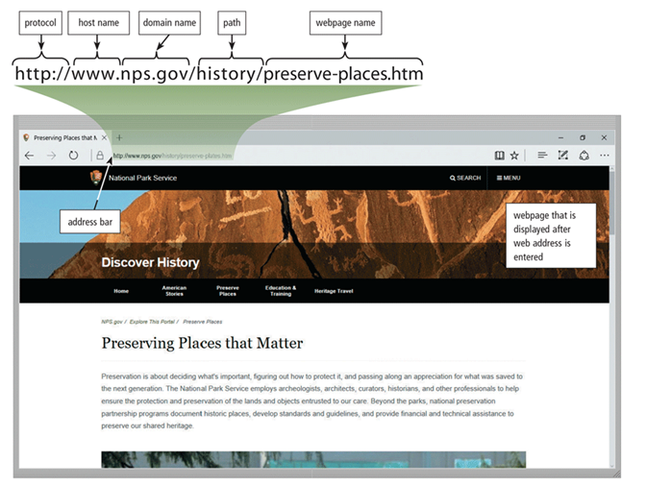
The World Wide Web (4 of 5)
A webpage has a unique address, called a web address or URL
Figure 2-8 After entering http://www.nps.gov/history/preserve-places.htm in the address bar and then pressing the ENTER key or clicking the Search, Go, or similar button in a browser, the U.S. Department of the Interior National Park Service home page shown here is displayed.

Slide 22
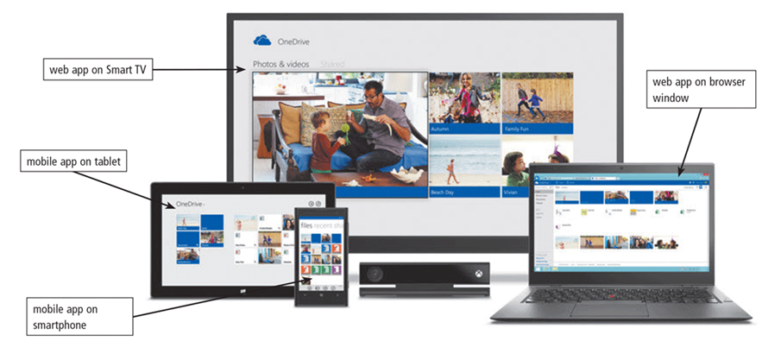
The World Wide Web (5 of 5)
A web app is an application stored on a web server that you access through a browser
Web apps usually store users’ data and information on their hosts’ servers
Figure 2-9 Web and mobile apps often work together, enabling you to access your content from a variety of computers and devices.

Slide 23
Types of Websites (1 of 8)
A web search engine is software that finds websites, webpages, images, videos, news, maps, and other information related to a specific topic
A subject directory classifies webpages in an organized set of categories, such as sports or shopping, and related subcategories

Slide 24
Types of Websites (2 of 8)
Operator | Description | Examples | Explanation
Space or + | Display search results that include specific words. | art + music art music | Results have both words, art and music, in any order
OR | Display search results that include only one word from a list. | dog OR puppy dog OR puppy OR canine | Results have either the word, dog, or the word, Puppy. Results have the word, dog, or the word, puppy, or the word, canine.
() | Combine search results that include specific words with those that include only one word from a list. | Kalamazoo Michigan (pizza OR subs) | Results include both words, Kalamazoo Michigan, and either the word, pizza, or the word, subs.
Notes:
Figure 2.3 Stages of change model

Slide 25
Types of Websites (3 of 8)
Operator | Description | Examples | Explanation
_ | Exclude a word from search results. | automobile-convertible | Results include the word, automobile, but do not include the word, convertible.
“ ” | Search for an exact phrase in a certain order. | "19th century literature" | Results include the exact phrase, 19th century literature.
* | Substitute characters in place of the asterisk. | writer* | Results include any word that begins with the text, writer (e.g., writer, writers, writer's)

Slide 26
Types of Websites (4 of 8)
There are several types of websites
Search engine
Online social network
Informational and research
Media sharing
Bookmarking
News, weather, sports, and other mass media

Slide 27
Types of Websites (5 of 8)
Educational
Business, governmental, and organizational
Blogs
Wiki and collaboration
Health and fitness
Science
Notes:
Figure 2.4 Goal setting and supportive behaviors

Slide 28
Types of Websites (6 of 8)
Entertainment
Banking and finance
Travel and tourism
Mapping
Retail and auctions

Slide 29
Types of Websites (7 of 8)
Careers and employment
E-commerce
Portals
Content aggregation
Website creation and management
Notes:
Figure 2.5 Model of progression and relapse

Slide 30
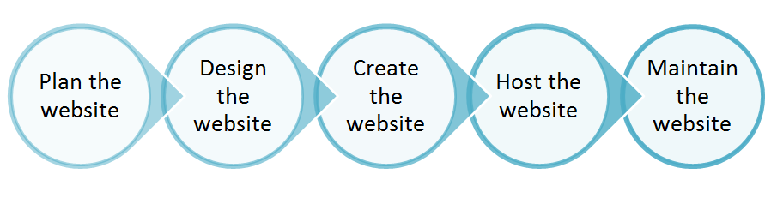
Types of Websites (8 of 8)
Web publishing is the creation and maintenance of websites

Slide 31
Digital Media on the Web (1 of 7)
Multimedia refers to any application that combines text with media
Graphics
Animation
Audio
Video
Virtual Reality

Slide 32
Digital Media on the Web (2 of 8)
A graphic is a visual representation of nontext information
Graphic formats include BMP, GIF, JPEG, PNG, and TIFF

Slide 33
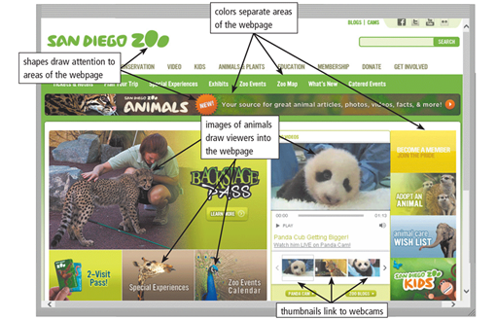
Digital Media on the Web (3 of 8)
Figure 2-22 Many webpages use colorful graphics to convey messages. For example, the variety of colors, images, shapes, and thumbnails on the San Diego Zoo webpage visually separate and draw attention to areas of the webpage, making the webpage more dynamic and enticing.

Slide 34
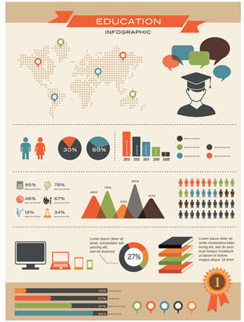
Digital Media on the Web (4 of 8)
An infographic is a visual representation of data and information, designed to communicate quickly, simplify complex concepts, or present patterns or trends
Figure 2-23 An infographic presents complex concepts at a glance.

Slide 35
Digital Media on the Web (6 of 11)
Animation is the appearance of motion created by displaying a series of still images in sequence

Slide 36
Digital Media on the Web (7 of 11)
Audio includes music, speech, or any other sound
Compressed to reduce file size
You listen to audio on your computer using a media player
Notes:
Figure 2.7 SMART goals

Slide 37
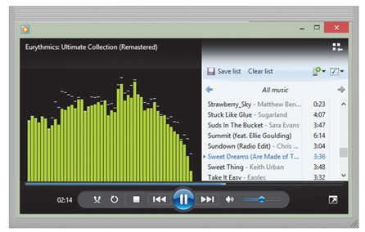
Digital Media on the Web (8 of 11)
Figure 2-24 Windows Media Player is a popular media player, through which you can listen to music and watch video.

Slide 38
Digital Media on the Web (9 of 11)
Video consists of images displayed in motion
Virtual reality (VR) is the use of computers to simulate a real or imagined environment that appears as a three-dimensional (3-D) space

Slide 39
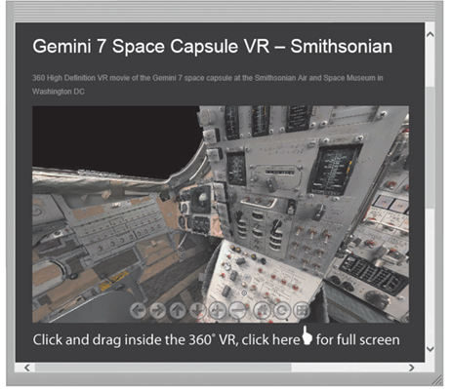
Digital Media on the Web (10 of 11)
Figure 2-25 Users can explore a VR world using a touch screen or their input device. For example, users can explore the inside of the Gemini 7 space capsule, located at the Smithsonian Air and Space Museum in Washington, D.C., from their computer or mobile device.

Slide 40
Digital Media on the Web (11 of 11)
A plug-in, add-on, or extension is a program that extends the capability of a browser

Slide 41
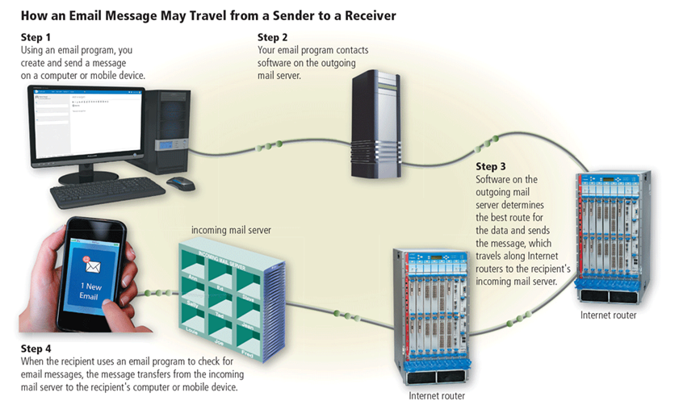
Other Internet Services (1 of 7)
Email is the transmission of messages and files via a computer network
An email program allows you to create, send, receive, forward, store, print, and delete email messages
Figure 2-26 This figure shows how an email message may travel from a sender to a receiver.

Slide 42
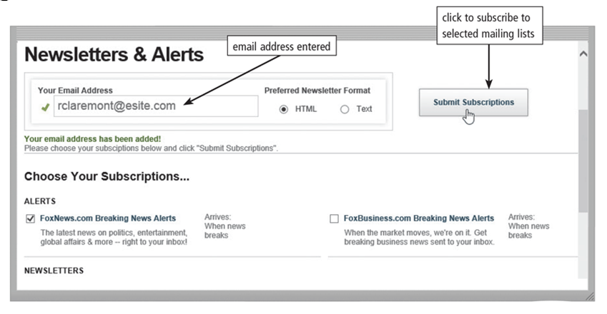
Other Internet Services (2 of 7)
An email list is a group of email addresses used for mass distribution of a message
Figure 2-27 When you subscribe to a mailing list, you and all others in the list receive messages from the website. Shown here is a user who receives newsletters and alerts from FoxNews .com.

Slide 43
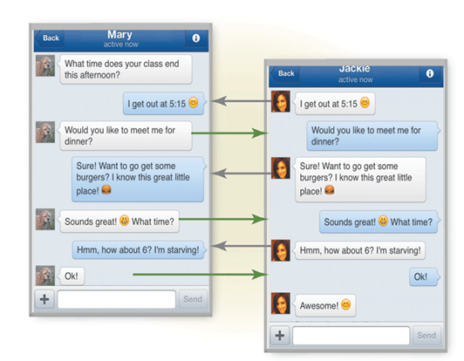
Other Internet Services (3 of 7)
Internet messaging services are communications services that notify you when one or more of your established contacts are online and then allows you to exchange messages or files or join a private chat room with them
Figure 2-28 With Internet messaging services, you and the person(s) with whom you are conversing are online at the same time. Shown here is Facebook messenger.

Slide 44
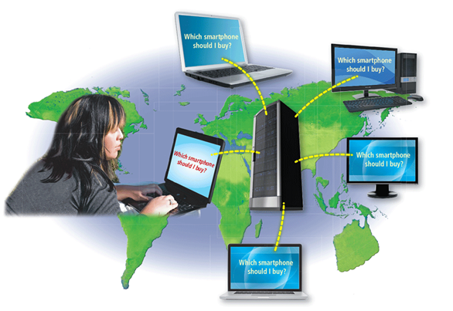
Other Internet Services (4 of 7)
A chat is a real-time typed conversation that takes place on a computer or mobile device with many other online users
A chat room is a website or application that permits users to chat with others who are online at the same time
Figure 2-29 As you type, others in the same chat room see what you have typed.

Slide 45
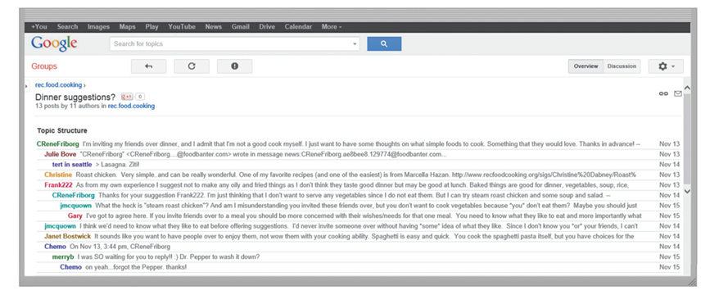
Other Internet Services (5 of 7)
An online discussion is an online area in which users have written discussions about a particular subject
Figure 2-30 Users in an line discussion read and reply to other user’s messages.

Slide 46
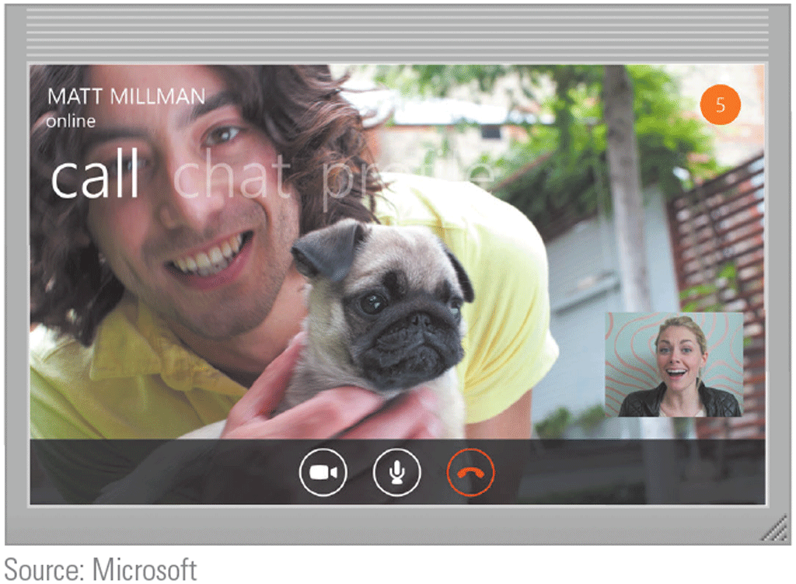
Other Internet Services (6 of 7)
VoIP (Voice over IP) enables users to speak to other users via their Internet connection
Source: Microsoft

Slide 47
Other Internet Services (7 of 7)
FTP (File Transfer Protocol) is an Internet standard that permits file uploading and downloading to and from other computers on the Internet
Many operating systems include FTP capabilities
An FTP server is a computer that allows users to upload and/or download files using FTP

Slide 48






Netiquette
Netiquette is the code of acceptable Internet behavior users should follow while on the Internet
Netiquette Guidelines for Online Communications Golden rule: Treat others as you would like them to treat you
Be polite. Avoid offensive language.
Avoid sending or posting flames, which are abusive or insulting messages. Do not participate in flame wars, which are exchanges of flames.
Be careful when using sarcasm and humor, as it might be misinterpreted.
Do not use all capital letters, which is the equivalent of SHOUTING!
Use emoticons and emojis to express emotions. Popular emoticons include: :) Smile :| Indifference :o Surprised :( Frown :\ Undecided ;) Wink Popular emojis include: Approval Tears of joy Love Happiness Boredom
Use abbreviations and acronyms for phrases: BTW by the way IMHO in my humble opinion FWIW for what it’s worth FYI for your information TTFN ta ta for now TYVM thank you very much
Clearly identify a spoiler, which is a message that reveals an outcome to a game or ending to a movie or program.
Be forgiving of other’s mistakes.
Read the FAQ (frequently asked questions), if one exists.
Lack of knowledge
Figure 2-31 Some of the rules of netiquette, with respect to online communications. (Source: Microsoft)

Slide 49
Summary
Evolution of the Internet
The web
Various types of websites and media
Other services available on the Internet
Netiquette

